Slide 1
MULTIPLE REGRESSION
presented by
Priyanka & Shrishti Agarwal

Slide 2
Multiple Regression
It is a statistical technique that can be used to analyze the relationship between a dependent variable and several independent variables.
Y=Xb+e
Assumptions:
1. Errors are normally distributed with a mean of 0.
2. Errors have equal variances(Homoscedasticity).
3. Errors are uncorrelated.
4. Xi’s are uncorrelated.

Slide 3
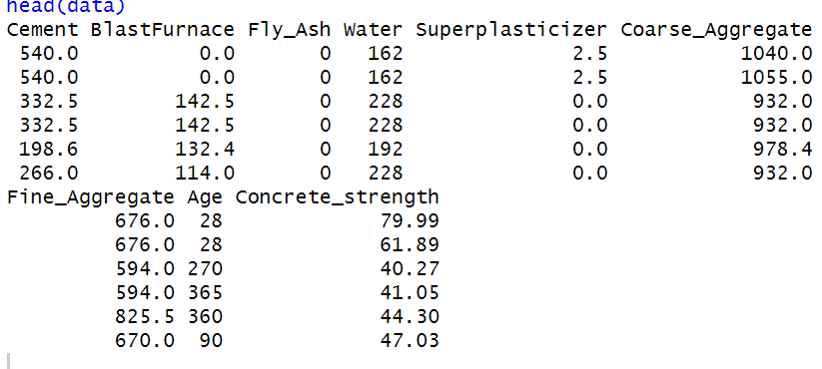
Data Collection
We collected dataset from Kaggle site. Link is: https://www.kaggle.com/datasets/niteshyadav3103/concrete-compressive-strength
Concrete is the most important
material in civil engineering.
The concrete compressive strength is a
output variable of our model
. The actual concrete compressive
strength (MPa) for a given mixture under a specific age (days) was determined from
laboratory.
Data is in raw form (not scaled).
Data Characteristics

Slide 4
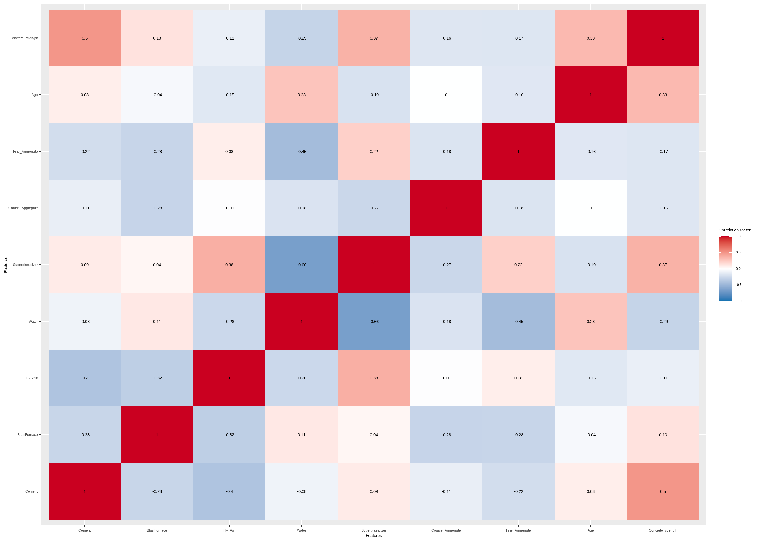
CORRELATION
MATRIX

Slide 5
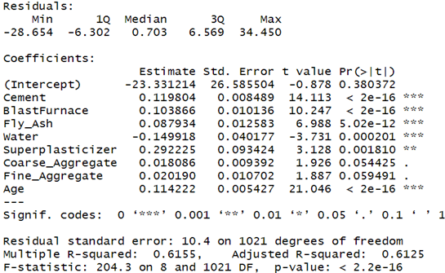
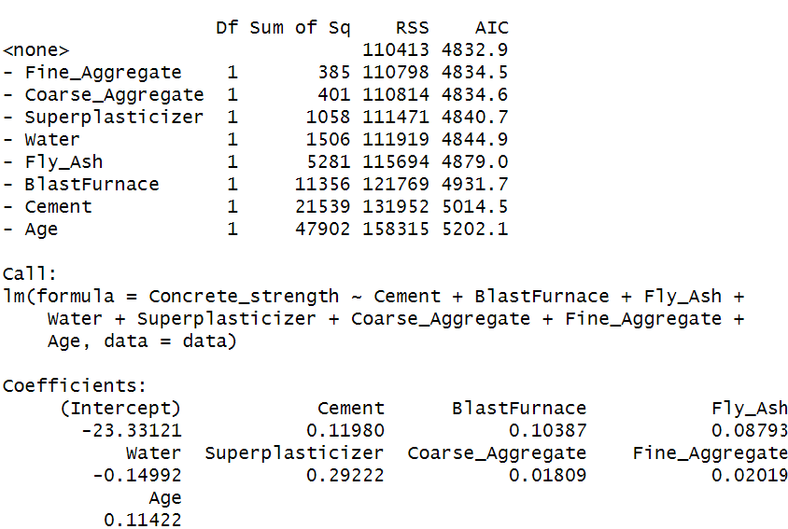
Cement, BlastFurnace, and Age are quite significant with p-value less than 2e-16.
AIC = 4832.9

Slide 6
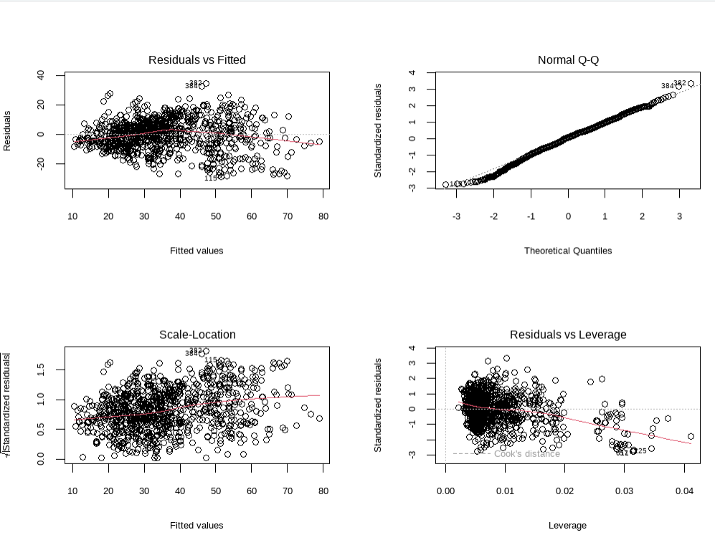

Slide 7
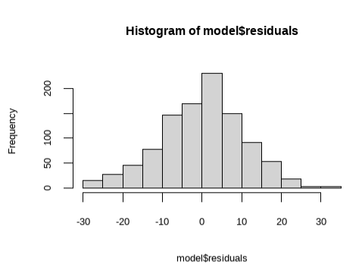
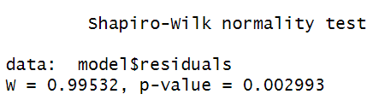
NORMALITY

Slide 8
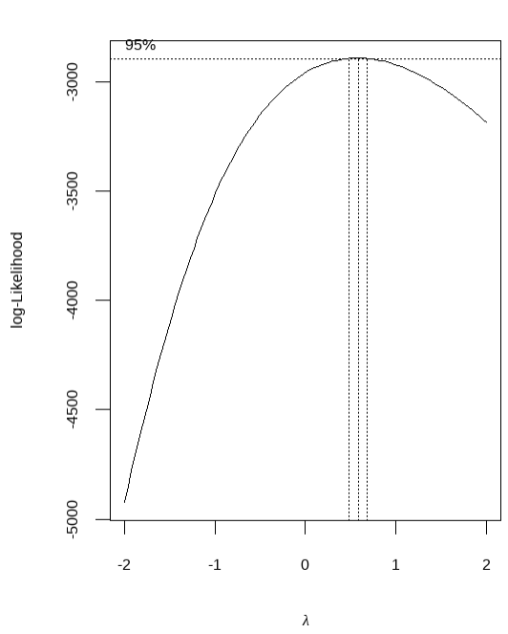
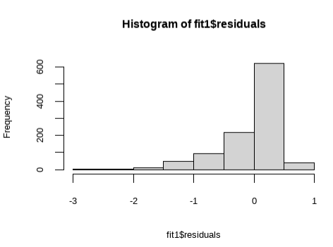


BOX COX
Transformation

Slide 9
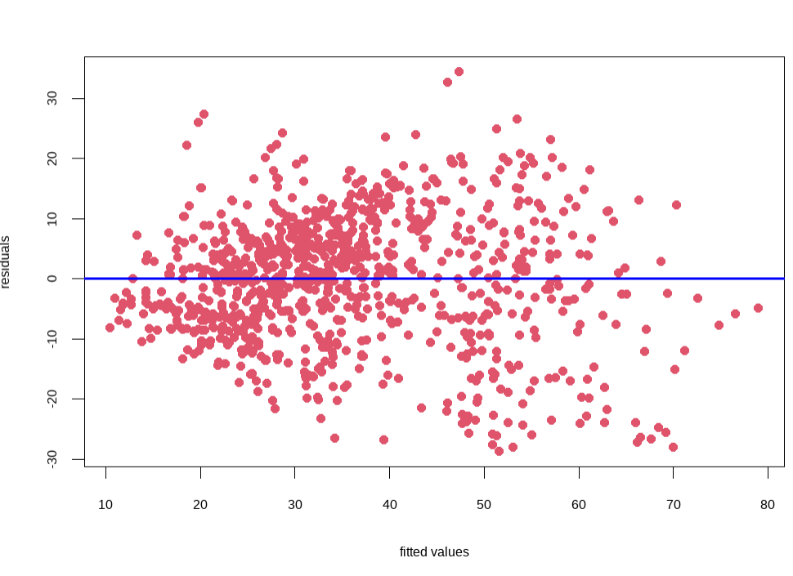
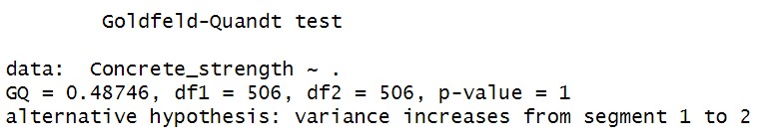
HETEROSCEDASTICITY

Slide 10
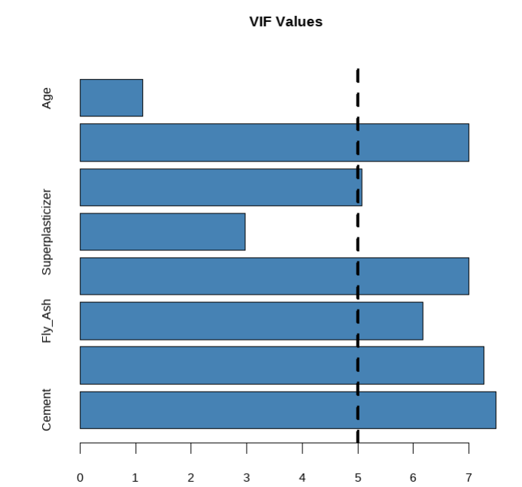
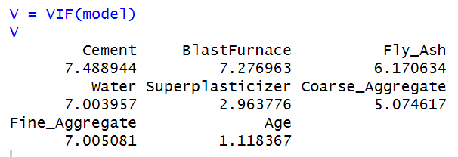
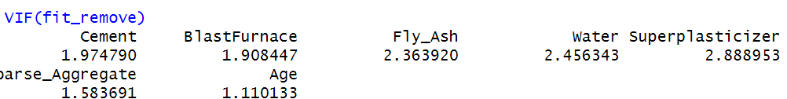
MULTICOLLINEARITY

Slide 11
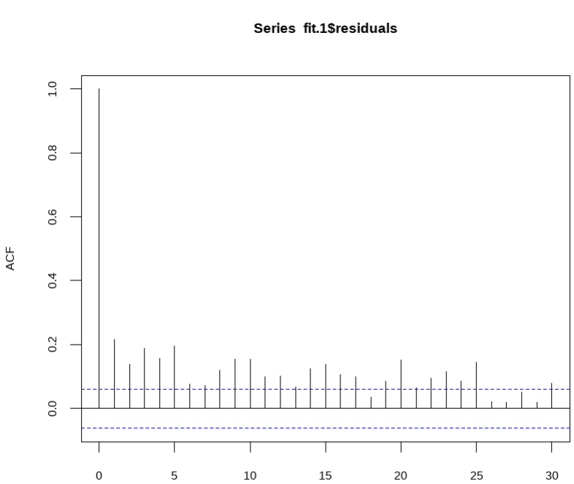
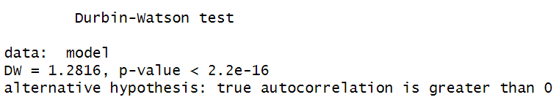
Auto Correlation
p-value = 0.8714

Slide 12
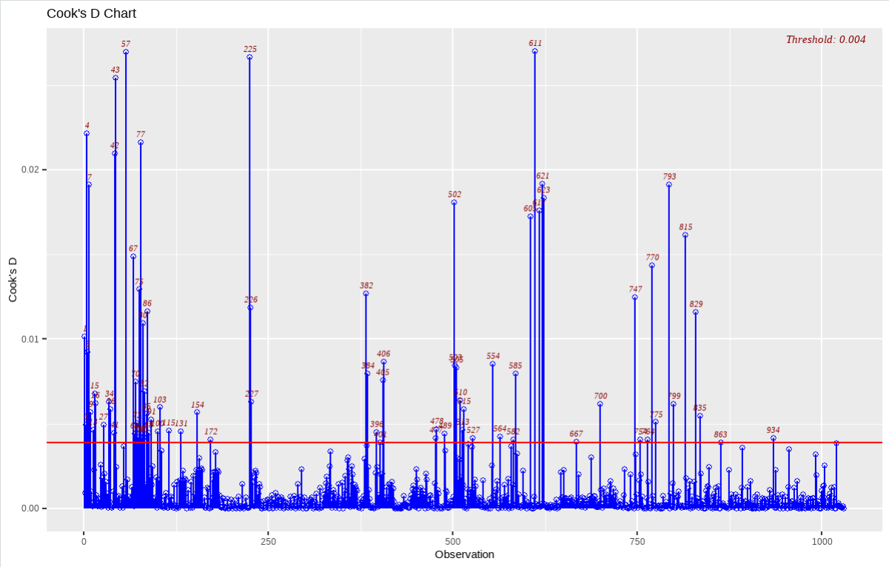

Outliers Detection
A rule of thumb is that observation has a high influence if Cook’s Distance exceeds 4/(n-p-1) , where
n- number of observations,
p – number of predictor variables
P.Bruce and Bruce, 2017

Slide 13
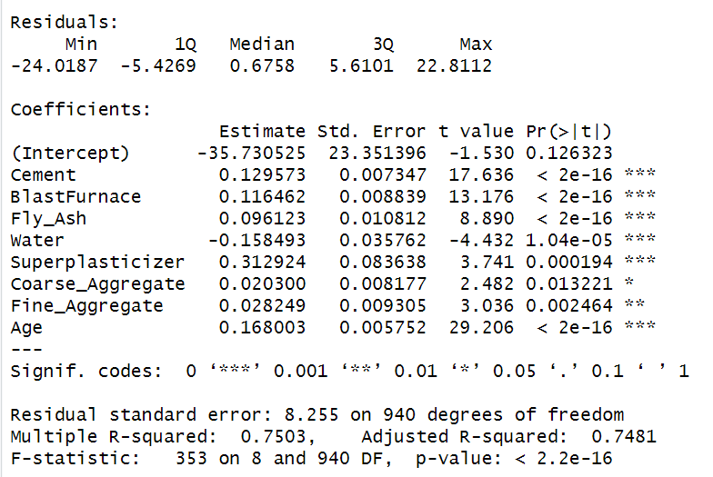
AIC = 4015.3
Finally, Our model equation can be written as follows:
Compressive Strength = -35 + 0.129*Cement +0.0116*Blast Furnace +0.096*Fly Ash -0.158*Water + 0.312*Superplasticizer +0.02*Coarse Aggregate + 0.028*Fine Aggregate + 0.168*Age

Slide 14
THANK YOU

